Slide 1

Car claims classification
Aleksander Tanskii
DS Classification project

Slide 2
Contents
Background and the problem and the data
EDA process
Preprocessing and Feature Engineering
Strategies and models used
Issues
Final results
Conclusions

Slide 3
Background and the problem
Nearly one of 10 Americans would commit insurance fraud if they knew they could get away with it. 3 of 10 Americans wouldn’t report insurance scams committed by someone they know
Insurance companies incur significant financial losses annually due to fraudulent claims.
These losses contribute to higher premiums for honest policyholders, impacting overall customer satisfaction.
A substantial amount of resources are dedicated to investigating and processing potentially fraudulent claims.
Fraudulent schemes are continuously evolving, making them harder to detect.
Conventional rule-based detection systems often fail to keep up with complex fraud patterns.
Widespread fraud can damage the reputation of insurance companies.

Slide 4
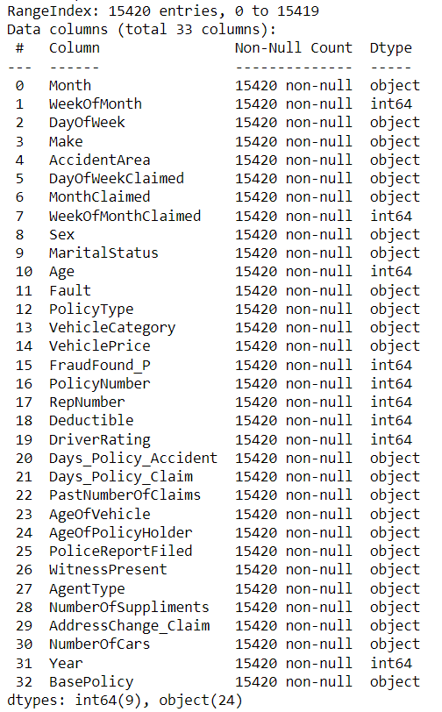
Data overview
The data set is taken from Kaggle
The data contains car insurance claims from 1994 to 1996 years
15.420 rows with 33 columns
Each record represents a unique car insurance claim
9 numerical and 24 categorical columns (technically all categorical)
The target variable contains 1 or 0 (‘FraudFound_P’)

Slide 5
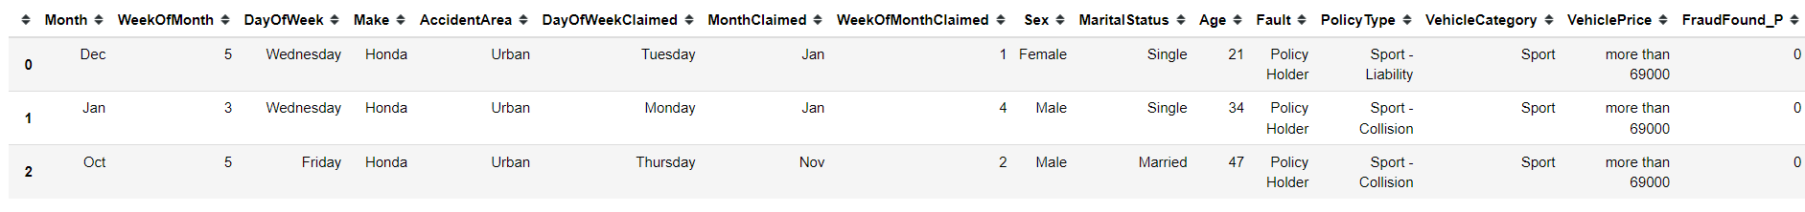
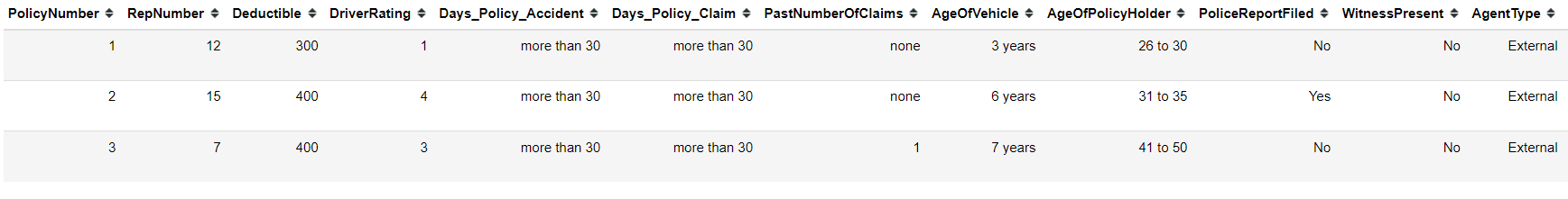
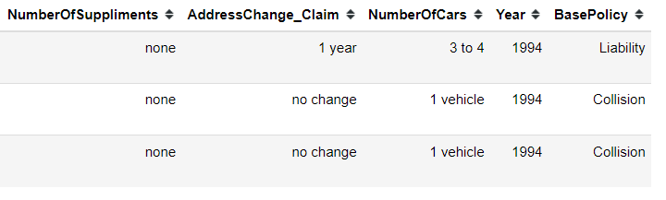
The data

Slide 6
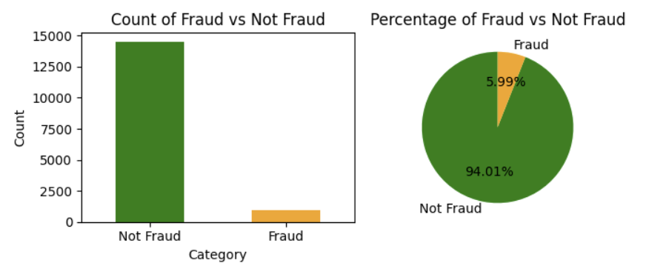
EDA
Target variable – FraudFound_P
The number of fraudulent cases is 923 out of 15.420
The fraudulent cases compile 5.99% of total data.

Slide 7
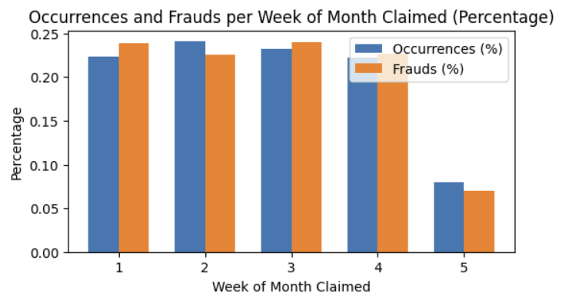
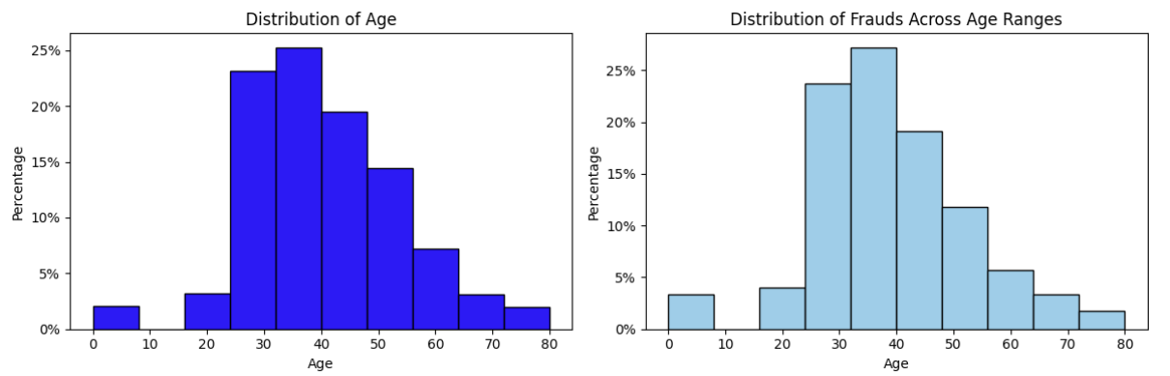
EDA
WeekOfMonthClaimed
The percentage of fraud is proportional to the number of claims per week
Age
As we can see the percentages of fraud per age is proportionate to the proportion of total clams per age

Slide 8
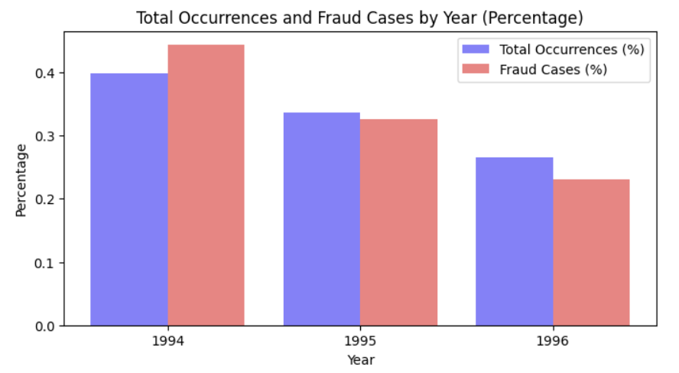
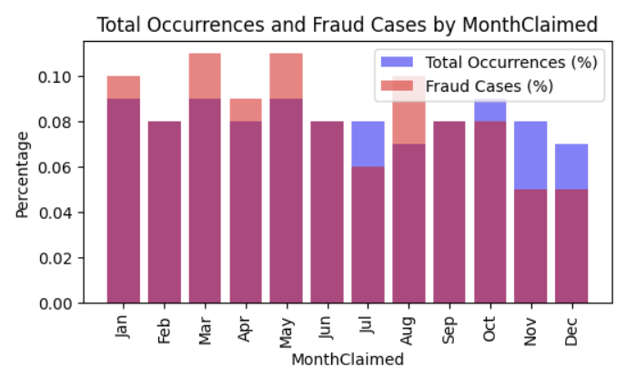
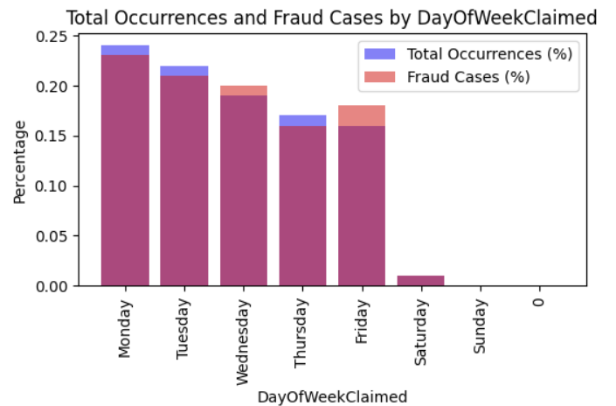
EDA
Year
1994 has more claims and, therefore, more fraud
The number of cases and fraud goes down along the year
MonthClaimed
As we can see the percentages of fraud per age is proportionate to the proportion of total clams per age
DayOfWeekClaimed
There are almost no claims on weekends
The num of claims goes down from Monday to Friday, so does the fraud

Slide 9
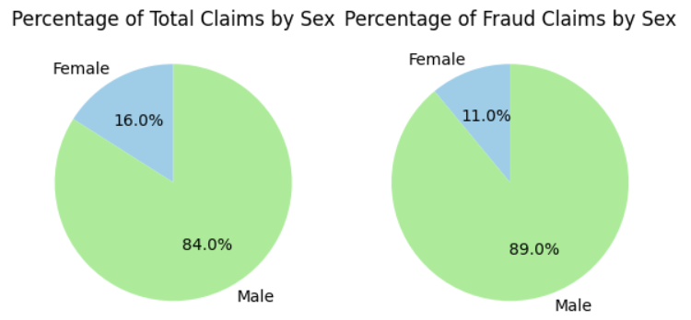
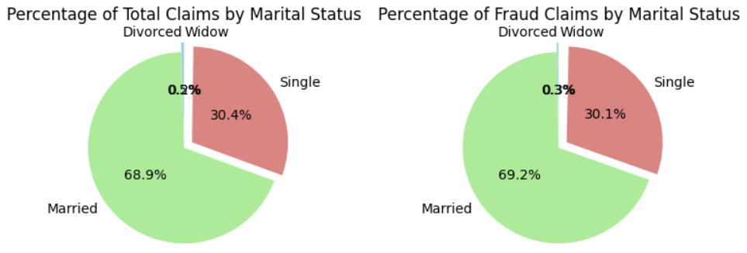
EDA
Sex
Males take up 84% of all claims
Males take up 89% of all fraud
MaritalStatus
The majority of claims and fraud is taken up by Married, almost 70%
30.4% by num and 30.1% is taken up by Single
The rest is taken up by 2 minor categories

Slide 10
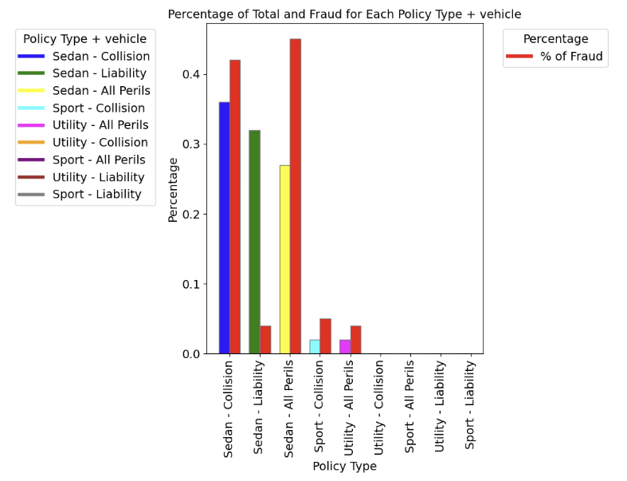
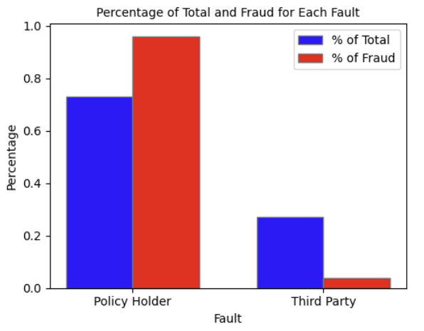
EDA
Fault
It’s policy holder’s fault in 73% of all cases
Policy holders take up 96% of all fraud
Type of vehicle + policy type
Sedan – Collision and Sedan – All Perils take up 87% of fraud and 63% of total claims
Sedan – Liability takes up 32% by count but only 4% of fraud
Sport – Collision and Utility – All Perils take up 4% by count buy 9% by fraud

Slide 11
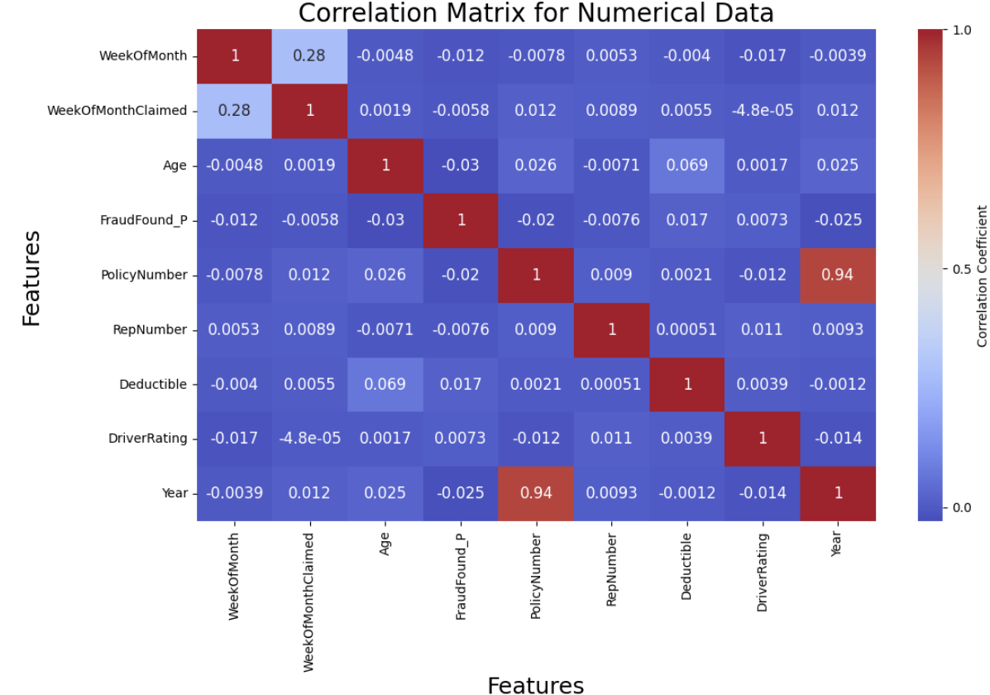
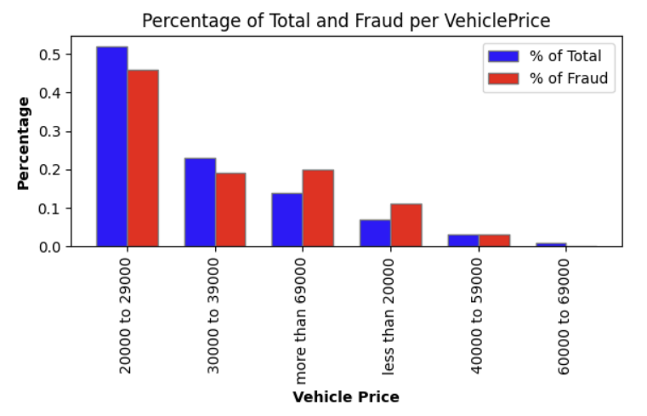
EDA
VehiclePrice
Most of the vehicles fall into the range 20000-29000
In general the % of fraud per category is proportionate to the % of total per category
Correlation matrix
There is no correlation between the numerical features apart from PolicyNumber and Year, which is useless

Slide 12
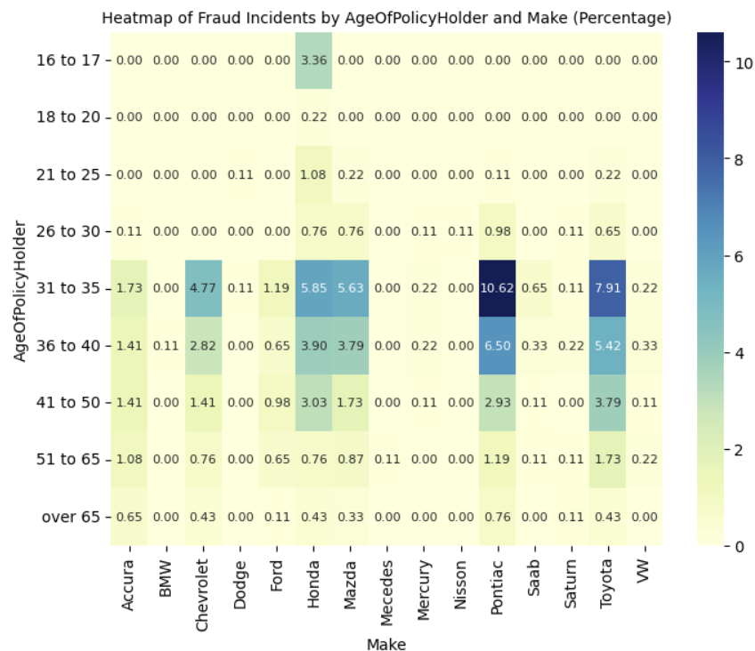
EDA
Heatmap AgeOfPolicyHolder vs Make
31-35 is the most fraudulent category, which takes up 36% by count and 39% by fraud
36-40 takes up 25% by count and 26% by fraud
41-50 takes up 18% by count and 16% by fraud
Pontiac is the make that take up 25% of total and 23% by fraud
Toyota takes up 20% by count and 20% by fraud
Honda takes up 18% by count and 19% by fraud

Slide 13
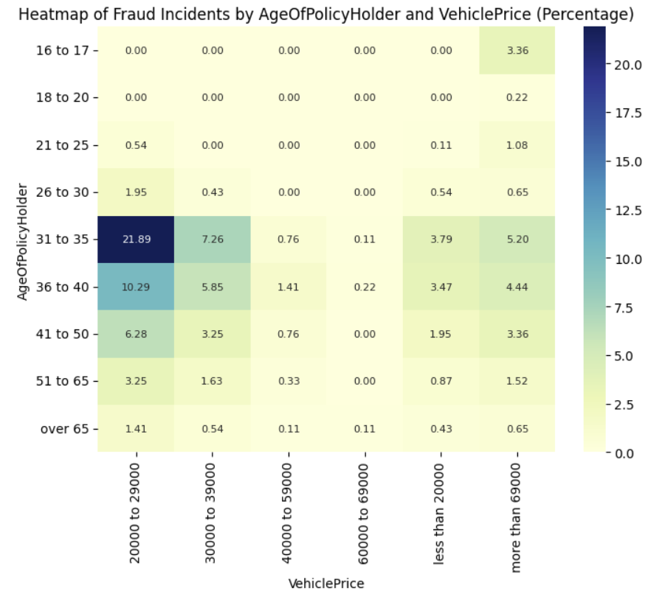
EDA
Heatmap AgeOfPolicyHolder vs VehiclePrice
20000 to 30000 is the most fraudulent category with 52% share by count and 45.6% of fraud
30000 to 39000 takes up 23% by count and 19% by fraud
More than 69000 takes up 14% by count and 20% by fraud
Less than 20000 is 7% by count and 11% by fraud
21.89% by fraud is taken by the age group 31-35 for the 20000 to 29000 price category

Slide 14
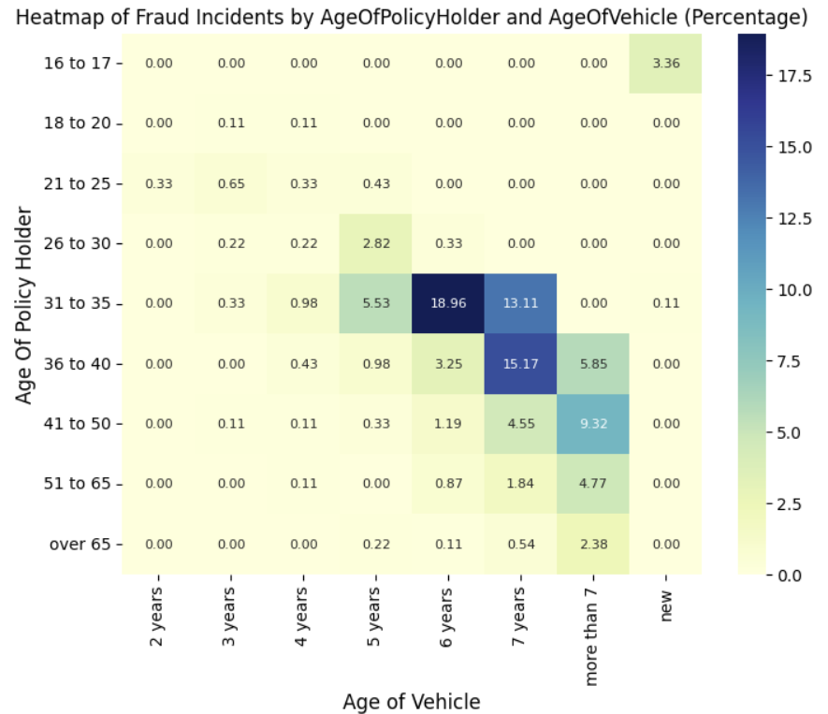
EDA
Heatmap AgeOfPolicyHolder vs AgeOfVehicle
37.3% by fraud is the age group of 31 to 35 and 5-7 yo vehicles
24.27% of fraud is in the 36-40 age group and for 6 yo and older vehicles
3.35% of fraud is commited by the young – 16-17 yo only with new vehicles
2 and 3 yo vehicles have almost no fraud

Slide 15
Preprocessing and Feature Engineering (for benchmark runs)
Preprocessing :
The data was split to have 25% for the test part
Columns removed: 'PolicyNumber’, ‘Age’
Transformation: as all of the columns appear to be categorical, even though originally they are integers, they have to be treated as categorical, therefore, OneHotEncoder was used
Feature Engineering :
Season was created and taken a look at. It was decided not to use it.
No other features could have been made. The data even had the combinations of single features.

Slide 16
Strategies and models used
Models chosen:
Logistic regression
Decision Trees
Random Forest
XGBoost
CatBoost
Voting (apart from Decision Trees)
Strategies:
A custom pipeline was created for each model. It included:
Gridsearch
Preset hyper parameters to check
Various proportions of non and fraudulent data with the help of SMOTE (mostly downsampling of non fraudulent part of the data)
F-beta was used as a metric for Gridsearch with various attemts to set the proportion between recall and precision, eventually was set to 1 (beta) which equals to f1
Eventually a double loop as run (smote in smotes and then cv in cvs) with gridsearch to find the best hyper parameters for each combination of smote modified data and cv
For each of the combination the best result with the best parameters is printed and at the end amonth those: the best and the worst overall of the results are printed
Voting (all of the models apart from Decision Trees)

Slide 17
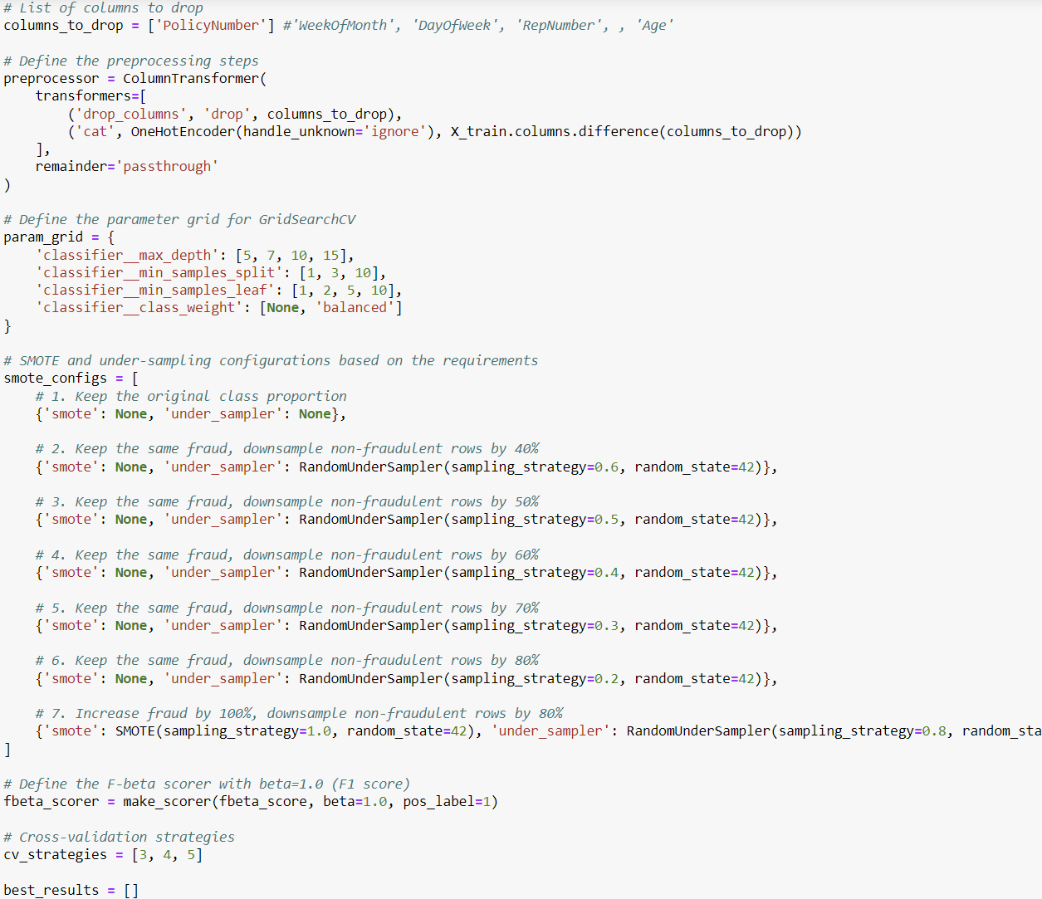
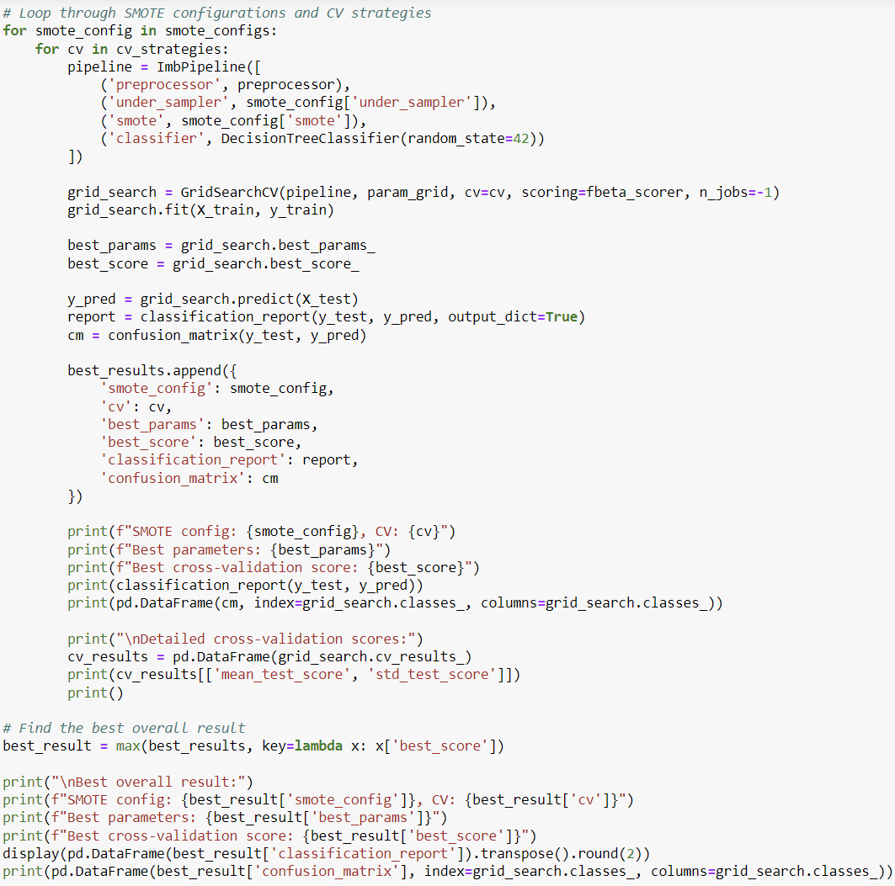
Example for Decision Trees

Slide 18
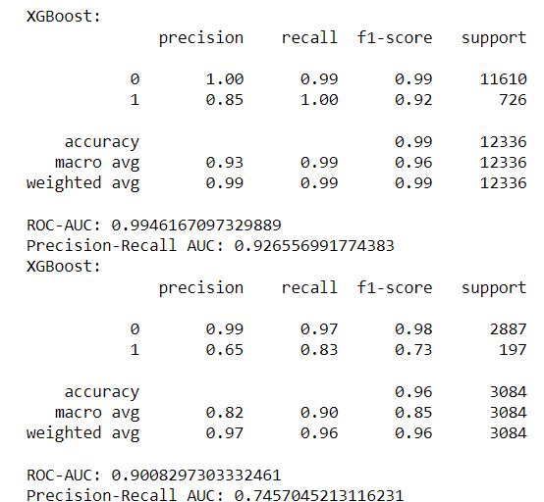
?
Issues
Overfitted model gave the best result (it had label encoding instead of hot encoding)

Slide 19
?
Issues
Overfitted model gave the best result (it had label encoding instead of hot encoding)
PolicyNumber !!!

Slide 20
Final results (test)
Model | Base precision | Base recall | Base f1 | Worst HP precision | Worst HP recall | Worst HP f1 | Best HP precision | Best HP recall | Best HP f1
Logistic Regression | 0.17 | 0.01 | 0.02 | 0.13 | 0.77 | 0.22 | 0.14 | 0.55 | 0.22
Decision Trees | 0.15 | 0.16 | 0.16 | 0.12 | 0.74 | 0.21 | 0.17 | 0.45 | 0.24
Random Forest | 1.0 | 0.14 | 0.24 | 0.27 | 0.21 | 0.24 | 0.20 | 0.39 | 0.26
XGBoost | 0.56 | 0.04 | 0.08 | 0.13 | 0.80 | 0.23 | 0.21 | 0.53 | 0.30
CatBoost | 1.0 | 0.03 | 0.05 | 0.13 | 0.87 | 0.23 | 0.21 | 0.52 | 0.30
Voter |  |  |  |  |  |  | 0.20 | 0.51 | 0.29

Slide 21
Conclusions
General conclusions:
Overall the results are left to be desired
Using Gridsearch didn’t help to find optimal hyper parameters
In addition to all, KNN and SVM were tried. They showed even poorer results
It is hardly possible to apply any of the tried models based on the results
Models:
Logistic regression , Decision Trees and Random Forest lag behind in performance
XGBoost and CatBoost show better results, however it is still not enough to rely on such
Voter didn’t improve the performance

Slide 22
Thank you for your attention!

